Slide 1
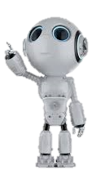
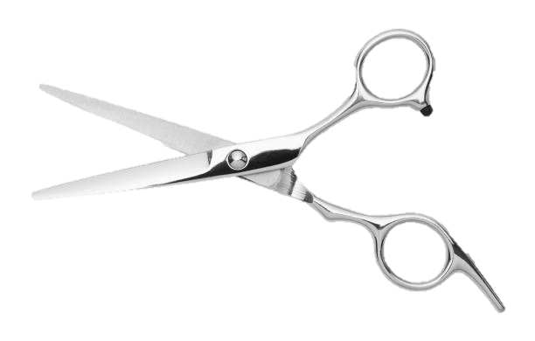
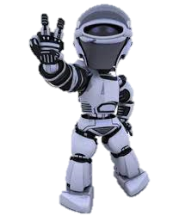
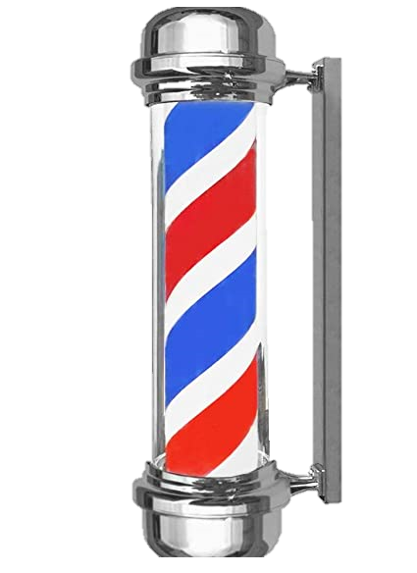
ROBOTEEN/PELUKING

Slide 2
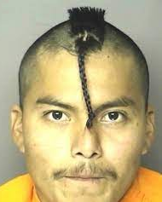
What is ROBOTEEN/PELUKING?
Roboteen/Peluking is a robot that is dedicated to cutting hair and has been created by the renowned Spanish inventors Carlos González, Ismael López, Javier Villaraco, Cristian Rivera and Jaime Valladolid.
The idea came up while they were in a barbershop waiting for a huge queue to get a haircut. Above Cristian was also dissatisfied with his court.
Christian's haircut

Slide 3
name's origin
We came up with the name after much discussion, we thought of creating a robot for children, which we would call Roboteen and another for people over eighteen we would call Peluking.

Slide 4
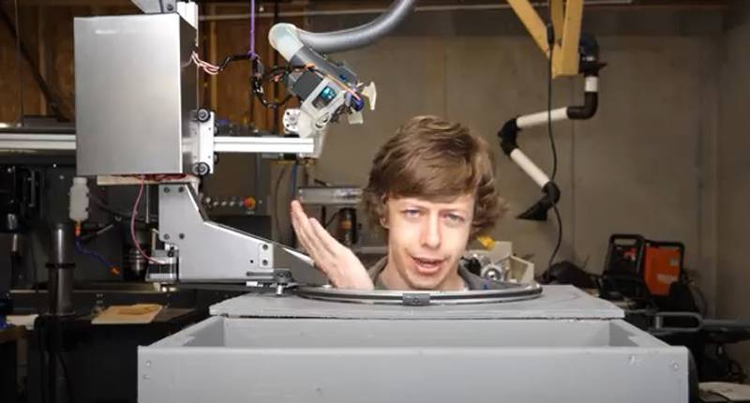
what makes?
It is a robot whose main purpose is to cut hair.
for example, it does a facial scan of the user who is going to cut their hair and shows you how the different hairstyles you want to do would look on you.
You can also choose other options such as beard grooming, facial treatment, hair dyeing, hair washing...
Another implementation is that it makes wigs with the hair of users who cut their hair

Slide 5
How does the robot to cut hair?
Through a revolutionized screen that it incorporates, we can choose and view the cut before we do it, even if we don't like it, we can cancel the cut and choose another one and see how it would look.
This is thanks to high-definition cameras that capture the dimensions of the head so as not to have any failures.
The cut is produced by the main mechanical arms of the robot, which reduce waiting time and have great precision.

Slide 6
How is it dyed?
Through the same screen that we mentioned before, we will get a series of options that we can select in order to have a perfect tint color since the robot itself can make another tint color if there is not the exact color
We also have a wide range of dyeing products that significantly reduce the inconvenience that bleaching or dyeing can cause, it also reduces the damage caused by the dye to the hair itself, as can happen with other products.

Slide 7
facial Treatment
The facial treatment option we have additional mechanical arms designed to perform extras, such as eyebrows, beard care, and many other revolutionary facial treatments...
These same mechanical arms are also in charge of the hairstyle once the cut is finished, in addition these are the ones that are in charge of making braids and similar hairstyles if you have selected it in the menu.

Slide 8
Modalities
There are two types of toupee robots roboteen and peluking
Roboteen can be used for young people, it has an integrated entertainment module in which it interacts with the client throughout the session so that they have a positive experience since, in addition, they will have fun after cutting their hair.
Peluking is more aimed at older people, this model has a more complex design since its personality is based on advanced artificial intelligence and it is capable of being self-taught and is based on knowing the tastes of each client and chatting with them in a friendly way. fluid and without faults in addition to a database included with current information.

Slide 9
Extras (dancebot)
Our robot has a personalized music bot that entertains during your stay with us
  Aplications → Enjoy the songs ,combine work with fun, dynamic use of artificial intelligence to match new trends and technologies
  Advantages → The other participants can change the songs to their liking, you can share the song in streaming if you wish, is always up to date
  Disadvantages → It is free, so there are many ads or limited use, it can fail when collapsing its metadata , it needs an internet connection to work
Having the new reality of this contemporary world where music has become essential for the daily life of the young and not so young, because we are in a connected world and it needs a bit of rhythm to enjoy the daily routine, like roboteen

Slide 10

Our shops
At the moment we are in these locations, we are in the process of expanding

Slide 11
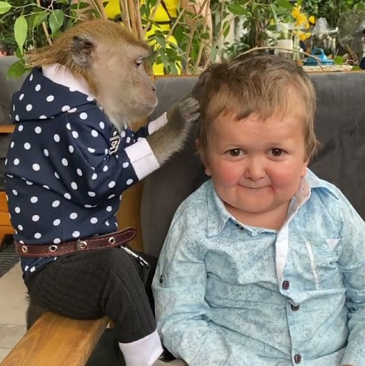
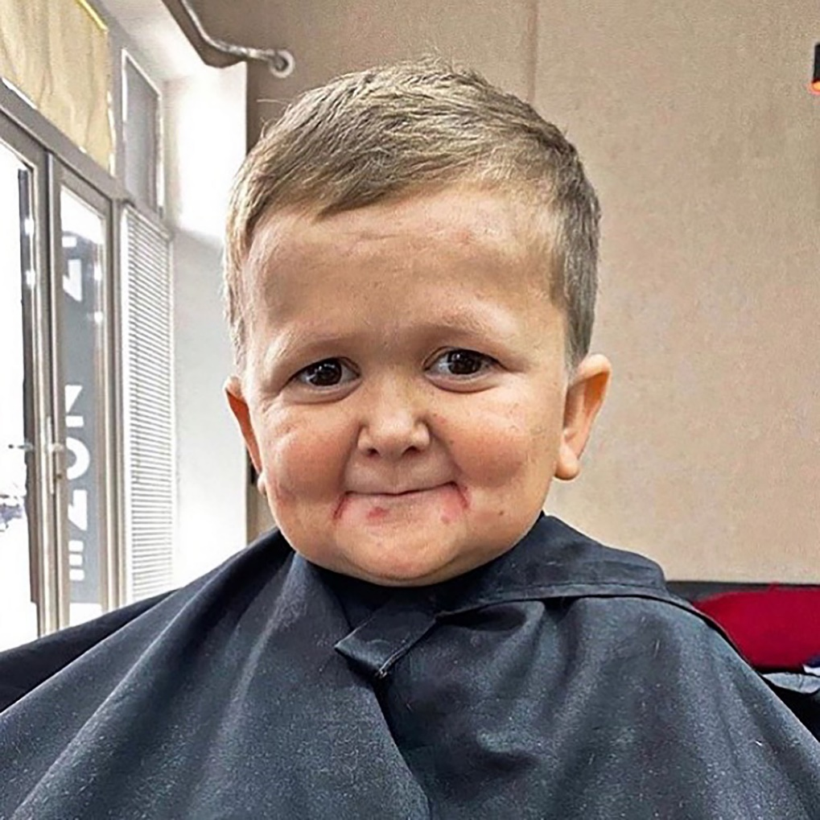
RESULTS
before
AFTER
Here we can see one of our first clients, who had a problem in another hairdresser and came requesting our services since we have a good reputation among clients.

Slide 12
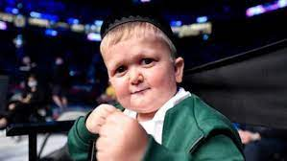
The end

